Slide 1
Thermal power generators (in Thermo, “heat engines”)

Slide 2
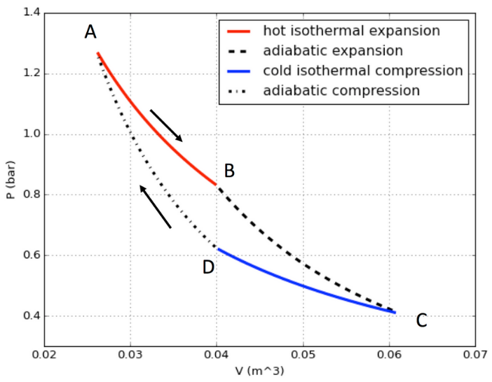

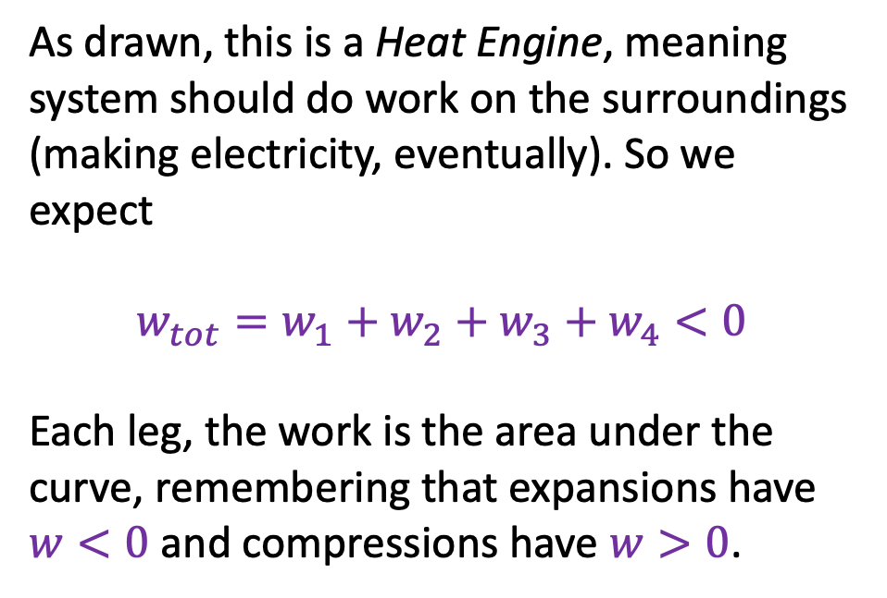



Thermal power generators (in Thermo, “heat engines”)
As drawn, this is a Heat Engine, meaning system should do work on the surroundings (making electricity, eventually). So we expect
$$w_{tot}=w_{1}+w_{2}+w_{3}+w_{4}<0$$
Each leg, the work is the area under the curve, remembering that expansions have $w<0$ and compressions have $w>0$.
$$w_{1}$$
$$w_{4}$$
$$w_{2}$$
$$w_{3}$$

Slide 3




Thermal power generators (in Thermo, “heat engines”)
The cost of running our power generator/heat engine is the fuel required to pour heat into our working gas during the hot isothermal expansion leg.
$$q_{1}$$
$$q_{4}=0$$
$$q_{2}=0$$
$$q_{3}$$

Slide 4
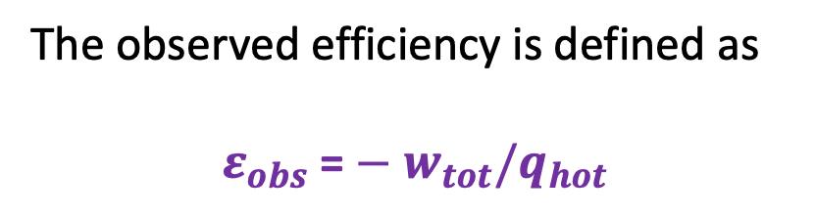
Thermal power generators (in Thermo, “heat engines”)
The observed efficiency is defined as
$${ε_{obs}\text{ =}−w}_{tot}/q_{hot}$$

Slide 5
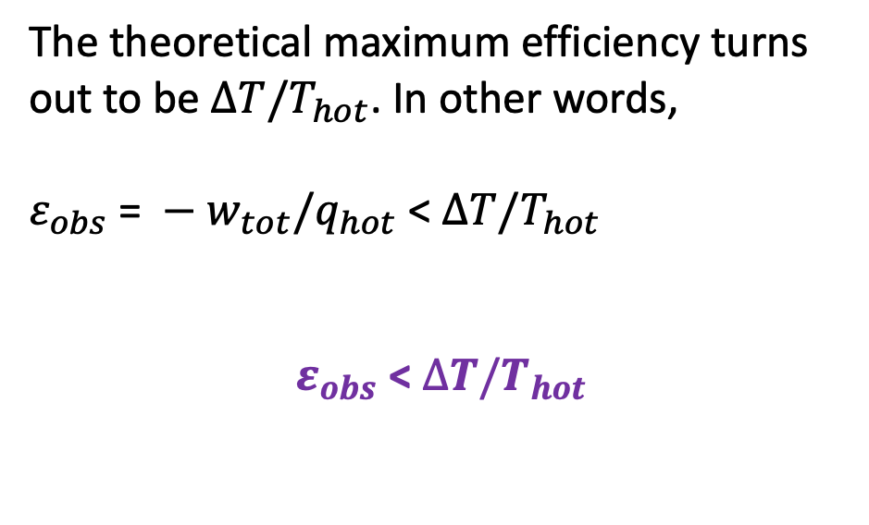
Thermal power generators (in Thermo, “heat engines”)
The theoretical maximum efficiency turns out to be $∆T/T_{hot}$. In other words,
${ε_{obs} \text{= }−w}_{tot}/q_{hot}$ < $∆T/T_{hot}$
$ε_{obs}$< $∆T/T_{hot}$
$$q_{1}$$
$$q_{4}=0$$
$$q_{2}=0$$
$$q_{3}$$

Slide 6








1. Derive this expression for isothermal PV work
$w=−nRTln(\frac{V_{2}}{V_{1}})$ ➔ $\frac{V_{2}}{V_{1}}=exp\left(−\frac{w}{nRT}\right)$
?
$$P_{ex}$$
$$P_{ex}$$
$$P_{2},V_{2}$$
$$P_{1},V_{1}$$
$$P_{ex}$$
$$P_{Ideal}=nRT/V$$
$$V_{1}$$
$$V_{2}$$

Slide 7

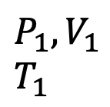


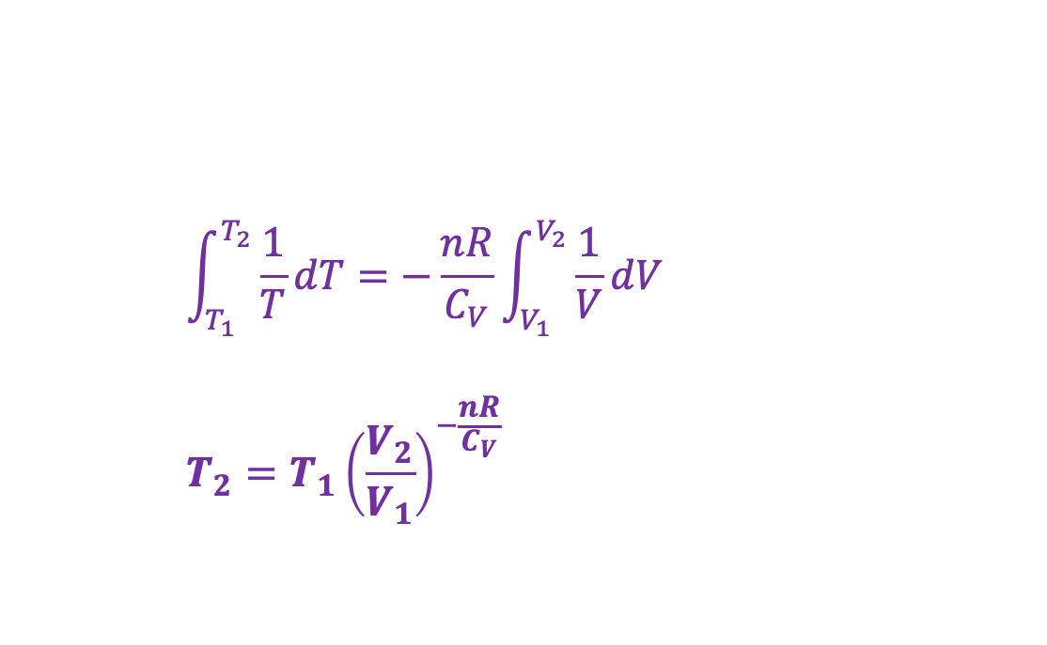



2. Derive this expression for multi-step adiabatic expansion of an ideal gas
$$\int_{T_{1}}^{T_{2}}{\frac{1}{T}dT}=−\frac{nR}{C_{V}}\int_{V_{1}}^{V_{2}}{\frac{1}{V}dV}$$
$$T_{2}=T_{1}{\left(\frac{V_{2}}{V_{1}}\right)}^{−\frac{nR}{C_{V}}}$$
$$U(T,V)$$
?
V
$$P_{ex}$$
T
$$P_{ex}$$
$$P_{2},V_{2}$$
$$T_{2}$$
$$P_{1},V_{1}$$
$$T_{1}$$
$$P_{ex}$$
No heat going in/out
Temperature is going down
$$P_{Ideal}=nRT/V$$
$$V_{1}$$
$$V_{2}$$

Slide 8

3. Derive this expression for multi-step adiabatic expansion of an ideal gas
$\frac{T_{2}}{T_{1}}={\left(\frac{V_{2}}{V_{1}}\right)}^{−\frac{nR}{C_{V}}}$
$P_{2}={P_{1}\left(\frac{V_{2}}{V_{1}}\right)}^{−\frac{nR}{C_{V}}−1}$
$$U(T,V)$$
?
V
$$P_{ex}$$
T
$$P_{ex}$$
$$P_{2},V_{2}$$
$$T_{2}$$
$$P_{1},V_{1}$$
$$T_{1}$$
$$P_{ex}$$
No heat going in/out
Temperature is going down
$$P_{Ideal}=nRT/V$$
$$V_{1}$$
$$V_{2}$$

Slide 9

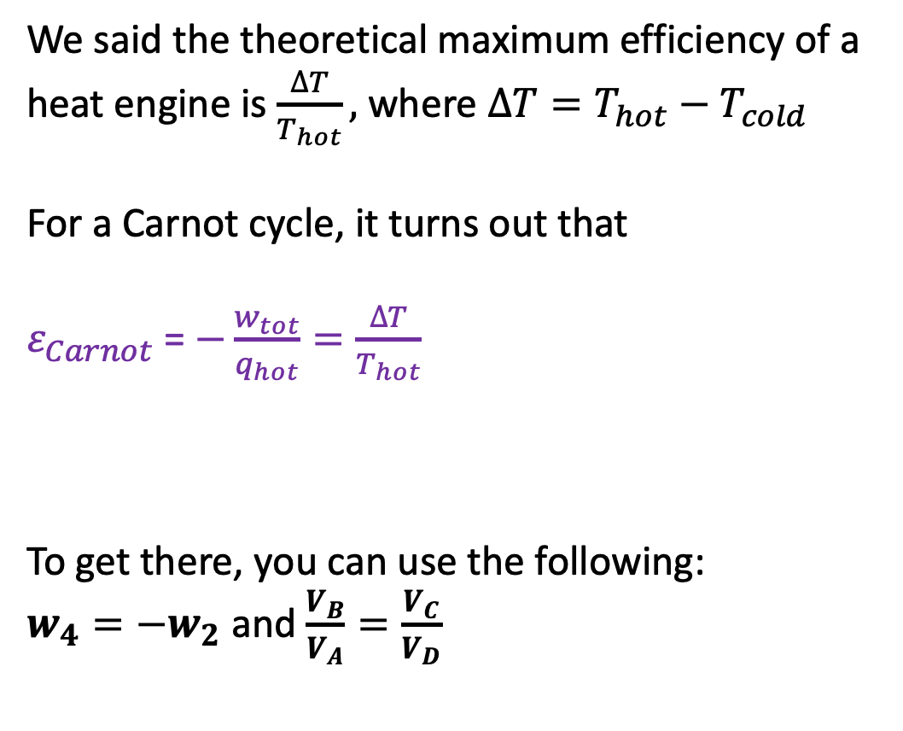



4. Show that the Carnot cycle’s efficiency really is the theoretical maximum
We said the theoretical maximum efficiency of a heat engine is $\frac{∆T}{T_{hot}},$where $∆T=T_{hot}−T_{cold}$
For a Carnot cycle, it turns out that
$ε_{Carnot}$= $−\frac{w_{tot}}{q_{hot}}=\frac{∆T}{T_{hot}}$
To get there, you can use the following:
$w_{4}=−w_{2}$ and $\frac{V_{B}}{V_{A}}=\frac{V_{C}}{V_{D}}$
$$w_{1}$$
$$w_{2}=−880 J$$
$$w_{4}=\text{+880 }\text{J}$$
?
$$w_{3}$$

Slide 10
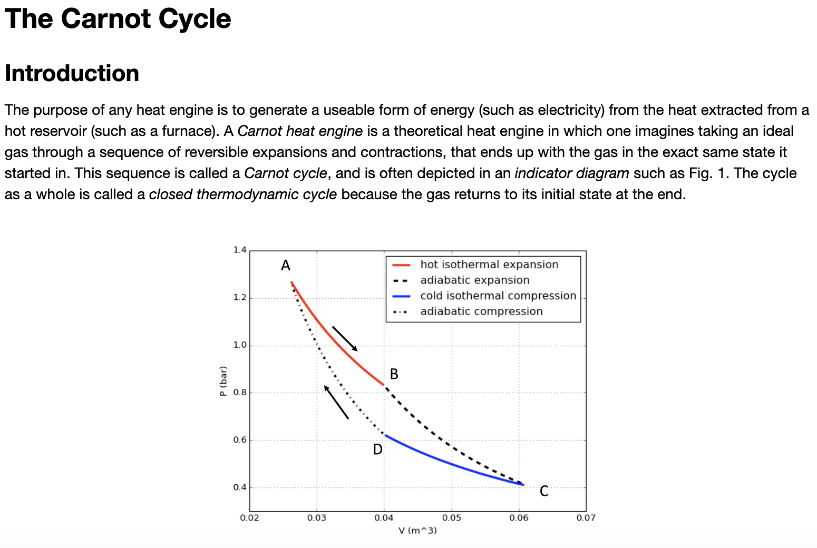
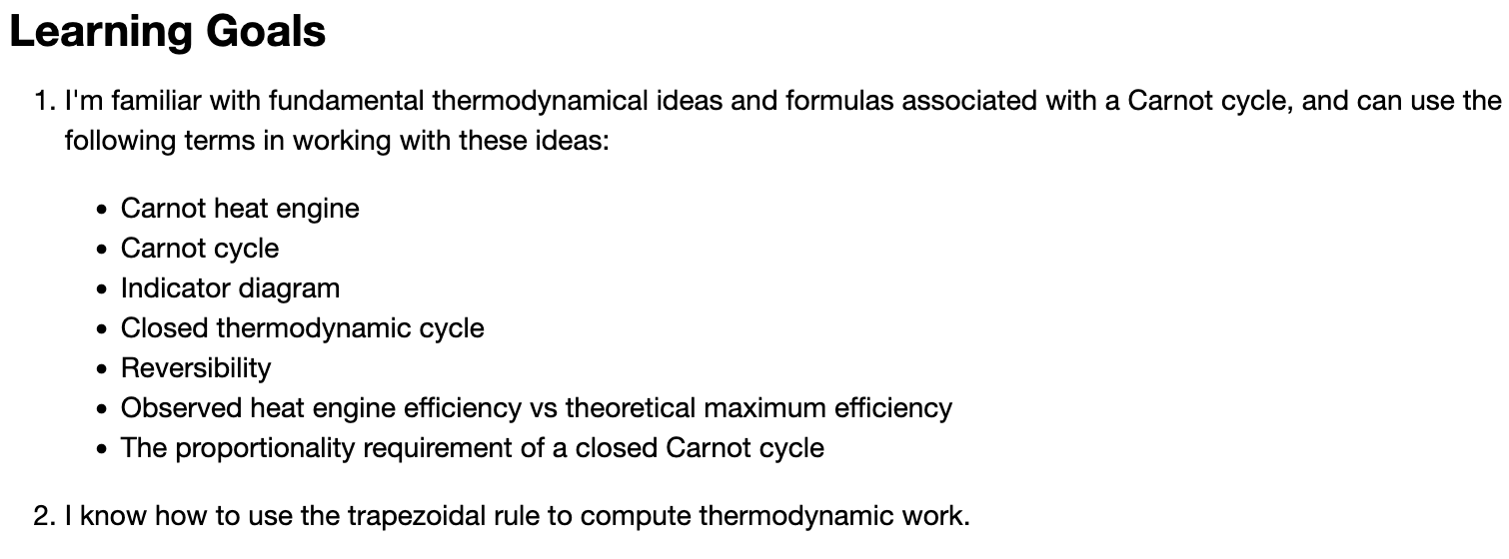
We’ll use the rest of the time on the Carnot Cycle CGI …

